Slide 1

BANGALORE INSTITUTE OF TECHNOLOGY
DEPARTMENT OF INFORMATION SCIENCE AND ENGINEERING
K.R.ROAD, V.V.PURAM, BANGALORE – 560004
Project Phase II Presentation (BIS685)
on
“CodeNCollab: A Virtual Coding Environment”
Presented By
NAME | USN
Praveen N Patil Namith Nagesh B C Rakesh S | 1BI22IS083 1BI22IS067 1BI22IS066 1BI22IS089
Under the Guidance of:
Prof. Priya N.V
Assistant Professor

Slide 2
Contents
Abstract
Highlights of the project features
Literature Survey
Problem Formulation
Analysis Modeling
System Architecture
Software Requirement Specification
Project Planning
Architecture Diagram
Detailed Component Diagram
Data Flow Diagram (DFD)
Use Case / Sequence Diagram
Reference

Slide 3
Highlights of the Project Features
Real-time Collaboration – Multiple users can join a room with a unique Room ID and code together instantly.
Multi-file & Folder Management – Create, edit, save, delete, and organize project files/folders.
Code Execution – Run programs directly inside the editor using Piston API and Docker.
Syntax Highlighting – Smart coding experience across different languages.
User Presence – Displays active users, join/leave alerts, and live editing indicators.
In-built Chat & Collaborative Drawing – Enhances communication and brainstorming during coding sessions.
AI Copilot Integration – Provides intelligent code suggestions and generation.
Customization – Multiple themes, adjustable font size & font family for personalized coding.
Download as ZIP – Export the complete codebase for offline use.

Slide 4
LITERATURE SURVEY
SI. No | year | Author(s) | Focus of the paper | Key Points in Coverage | Techniques(s) used | Parameters Analyzed | Research Gaps
1 | 2023 | Feng, L., Yen, R., You, Y., Fan, M., Zhao, J., and Lu, Z | Prompt collaboration in coding | Introduces CoPrompt for sharing prompts | CoPrompt system | Collaboration quality | Limited to NL-based coding
2 | 2023 | Xinyue Chen Li, S., Liu, S., Fowler. | Transcript-based coding meetings | Uses MeetScript for live transcripts | Interactive transcripts | Engagement, decisions | Not tailored for coding platforms
3 | 2023 | Dong, Y., Jiang, X., Jin, Z. | Multi-agent code generation | Agents collaborate using roles | ChatGPT + role prompts | Output quality | Focused only on LLMs
4 | 2024 | Gaikwad, A., Agrawal, M., Goyal | Real-time AI code collaboration | AI-assisted multi-user editor | AI + code editor integration | Performance, usability | User metrics not detailed
5 | 2021 | Lin Shi et al. | Live developer chat analysis | Studies dev chats on Gitter | Empirical log analysis | Interaction types | Platform-specific only

Slide 5
LITERATURE SURVEY
SI. No | year | Author(s) | Focus of the paper | Key Points in Coverage | Techniques(s) used | Parameters Analyzed | Research Gaps
6 | 2023 | Fathima, G., Kaif, M., and Nadeem. | Online code execution platform | CODEGEN with multi-lang & real-time run | React-based system | Language support, UI | React-bound implementation
7 | 2023 | Rajeev Verma. | Web IDE with real-time features | Discusses sync & latency | Collaborative editing logic | Latency, conflict mgmt | No real-user validation
8 | 2023 | Meenal Kaur. | Multi-user collaborative editors | Examines collab protocols | Shared editing protocols | Sync accuracy | Adoption not evaluated
9 | 2023 | Ann Yi Wong. | Security in Docker containers | Threat modeling for sandboxing | Docker attack analysis | Vulnerabilities, fixes | Generalized to container tech only
10 | 2023 | Karthik Sinha. | Docker container risks | Evaluates Docker’s flaws | Security audit | Isolation, attack surface | Not focused on collab tools

Slide 6
Problem Formulation
Need for a platform where multiple users can code together in real-time
Requirement of unique room creation & sharing for seamless collaboration
Essential to provide multi-file and folder management in a shared environment
Support for instant synchronization of code changes across all users
Inclusion of built-in communication tools like chat and collaborative drawing
Integration of AI assistance to improve coding efficiency
Ability to execute code directly within the collaborative workspace
Option to customize editor with themes, fonts, and layouts

Slide 7
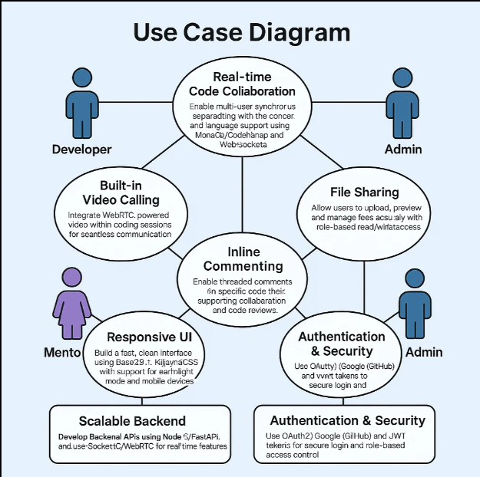
Analysis Modeling
Core Functions:
Collaborative coding
Session creation/joining
Real-time editing, video conferencing
Chat, file sharing, activity tracking
Token-based authentication
Architecture Components:
User Management
Code Editor (Real-Time Collaboration, Sync)
Chat Module (Text Communication)
File Sharing Module
Security Layer (RBAC, JWT/Auth)
Database Layer (MongoDB + Mongoose)
Real-Time Engine (Socket.IO)

Slide 8
Analysis Modeling
Workflow:
Developer/Mentor/Admin logs in securely via the UI
Mentor creates a session and invites mentees
Users join the session using unique identifiers
Communication happens via integrated chat and video modules
Files can be shared securely during the session
Role-based controls manage access to features
Code editor syncs real-time changes across participants
System tracks session activities and stores history
Token-based authentication ensures secure operations

Slide 9
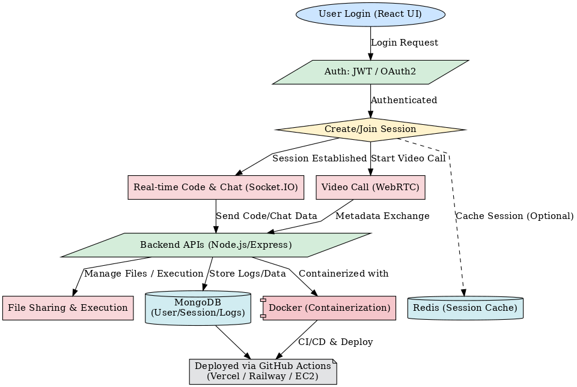
System Architecture

Slide 10
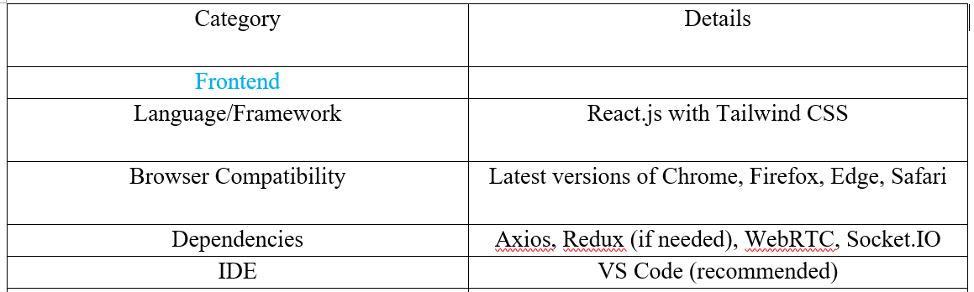
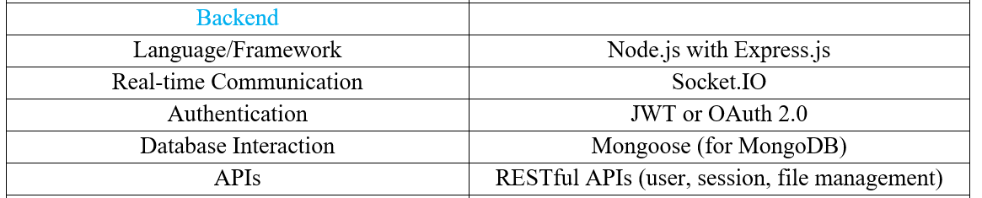
Software Requirement Specification

Slide 11
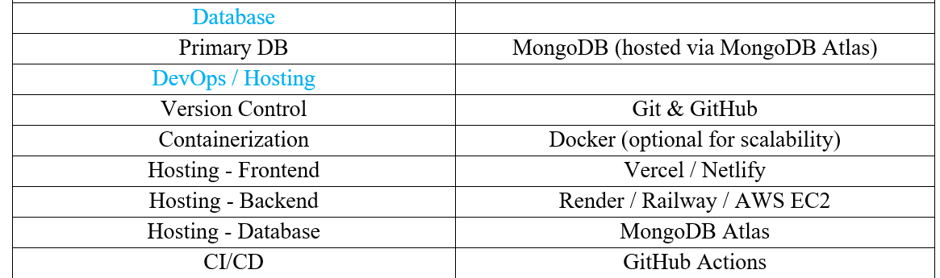
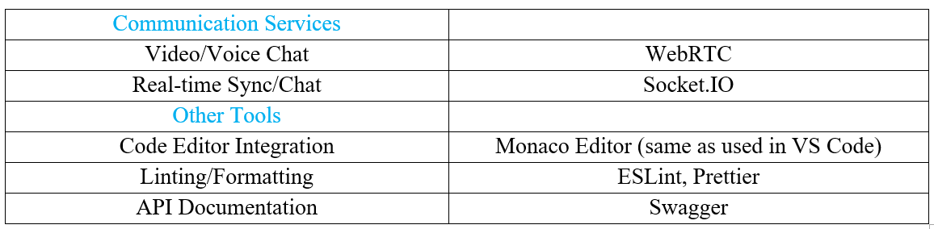
Software Requirement Specification

Slide 12
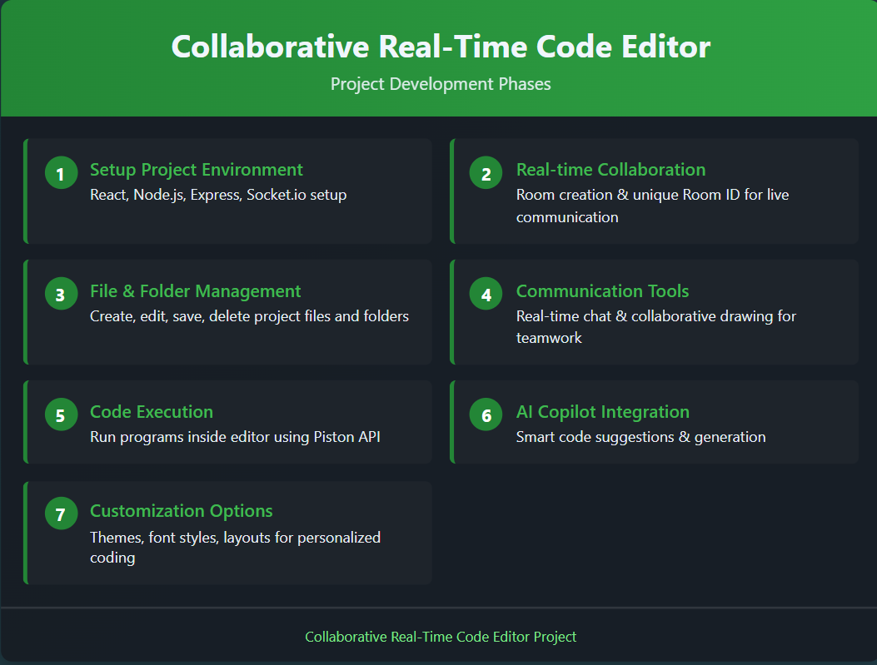
Project Planning

Slide 13
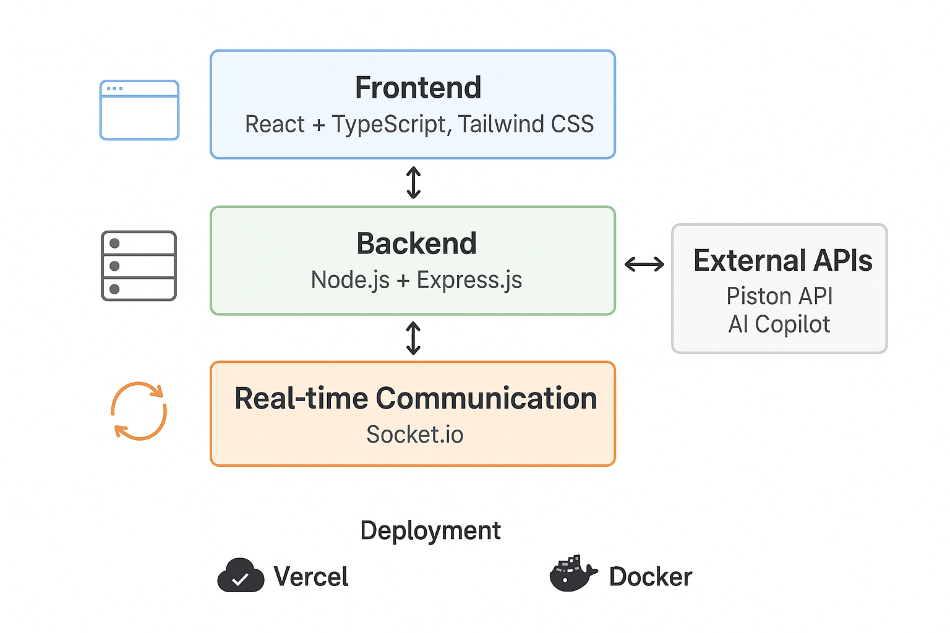
ARCHITECTURE DIAGRAM

Slide 14
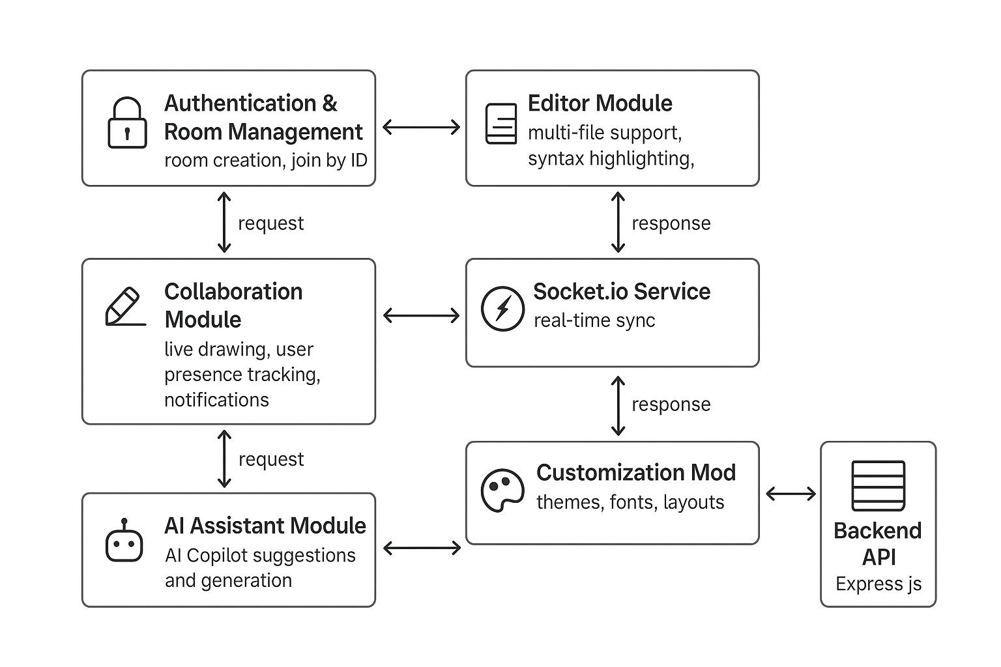
DETAILED COMPONENT DIAGRAM

Slide 15
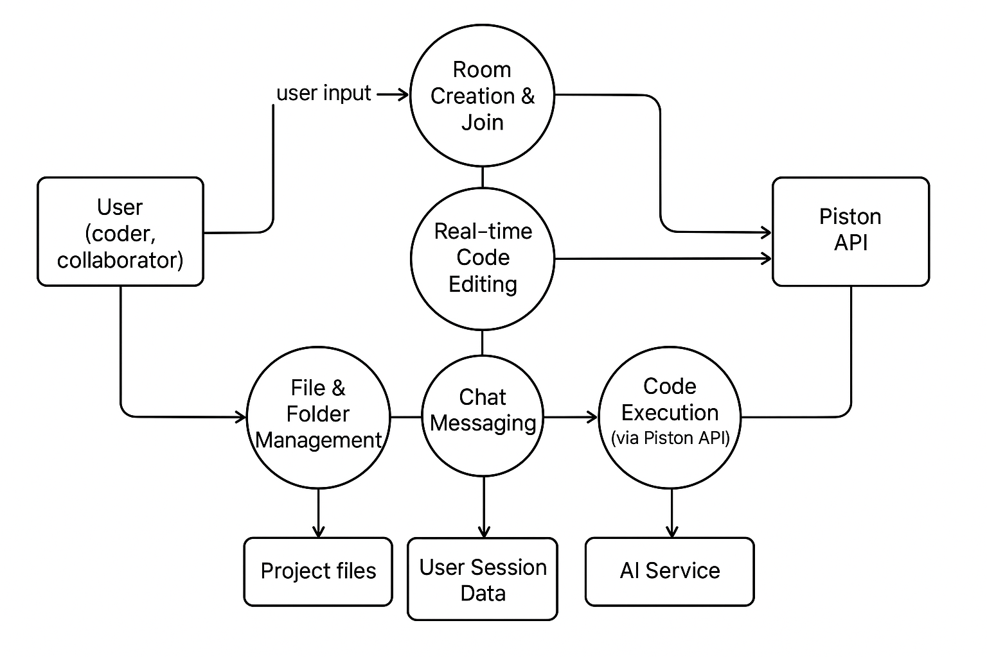
DATA FLOW DIAGRAM (DFD)

Slide 16
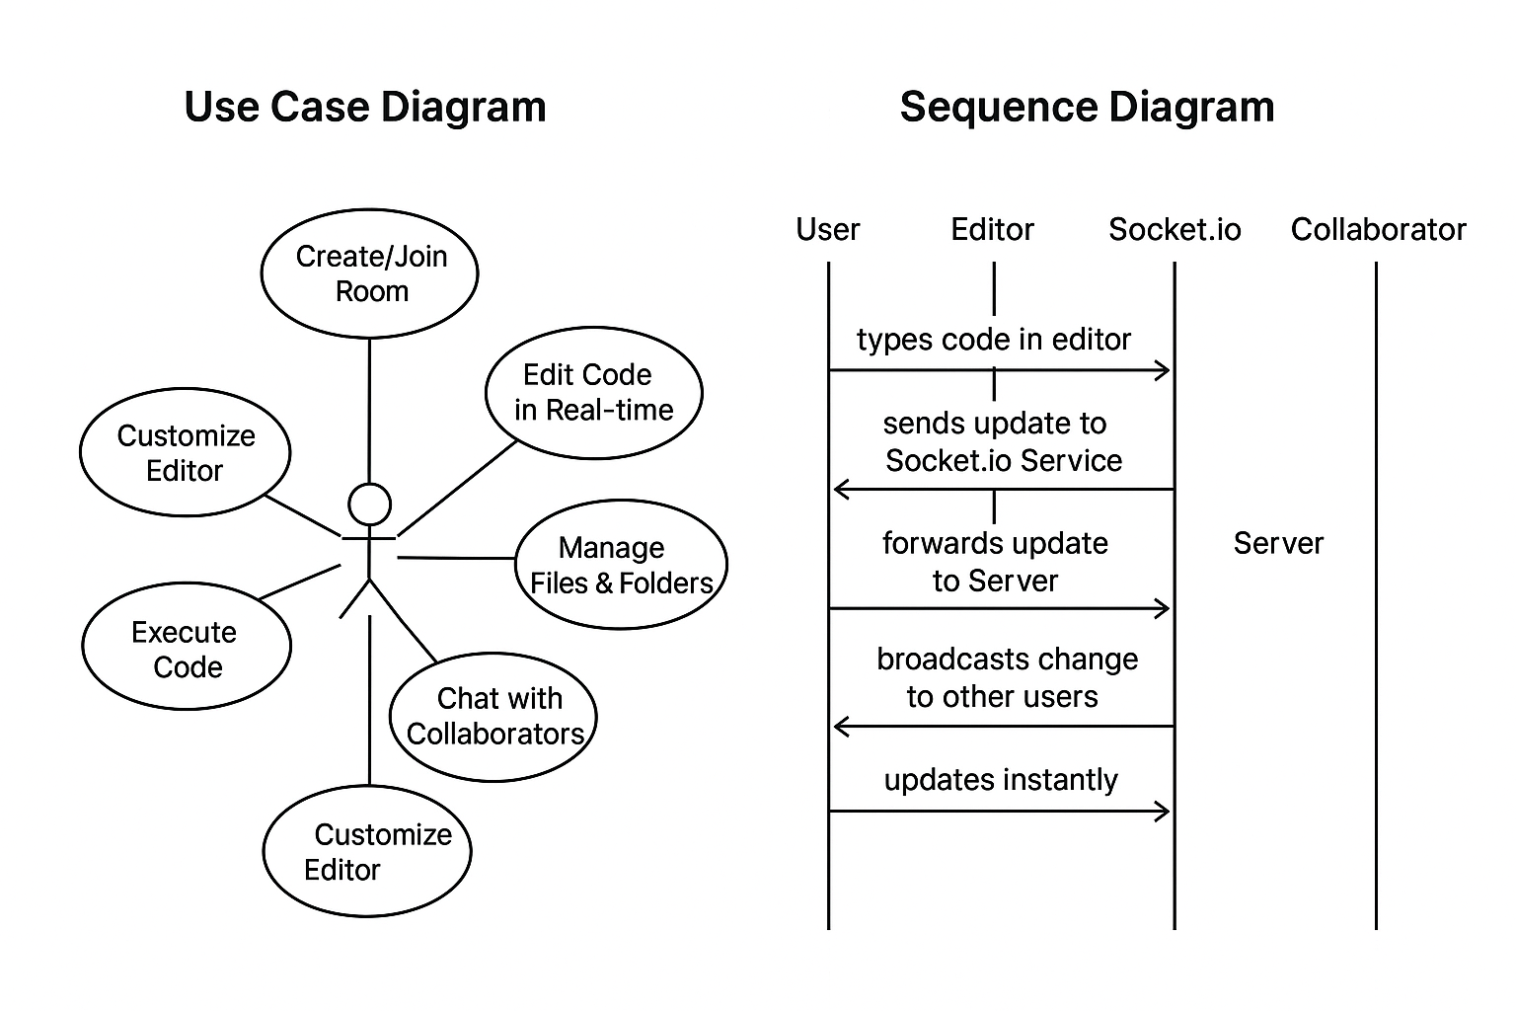
USE CASE / SEQUENCE DIAGRAM

Slide 17
REFERENCES
[1] Feng, L., Yen, R., You, Y., Fan, M., Zhao, J., and Lu, Z. “CoPrompt: Supporting Prompt Sharing and Referring in Collaborative Natural Language Programming.” arXiv, vol. 2310.09235, arXiv, 2023, https://arxiv.org/abs/2310.09235.
[2] Chen, X., Li, S., Liu, S., Fowler, R., and Wang, X. “MeetScript: Designing Transcript-Based Interactions to Support Active Participation in Group Video Meetings.” Proceedings of the ACM on Human-Computer Interaction, vol. 7, no. CSCW2, Article 254, ACM, 2023, https://doi.org/10.1145/3610397.
[3] Dong, Y., Jiang, X., Jin, Z., and Li, G. “Self-Collaboration Code Generation via ChatGPT.” ACM Transactions on Software Engineering and Methodology (TOSEM), ACM, 2023, https://doi.org/10.1145/3645669.
[4] Gaikwad, A., Agrawal, M., Goyal, J., Goyal, M., and Vinod, D. F. “A Collaborative Code Platform with Advanced AI Features and Real-Time Collaboration Tools.” International Journal for Research in Applied Science and Engineering Technology, vol. 12, no. 5, 1234–1242, IJRASET, 2024, https://doi.org/10.22214/ijraset.2024.
[5] Shi, L., Chen, X., Yang, Y., Jiang, H., Jiang, Z., Niu, N., and Wang, Q. “A First Look at Developers' Live Chat on Gitter.” Proceedings of the 29th ACM Joint Meeting on European Software Engineering Conference and Symposium on the Foundations of Software Engineering (ESEC/FSE '21), ACM, 2021, pp. 573–584.
.

Slide 18
REFERENCES
[6] Fathima, G., Kaif, M., and Nadeem, M. “CODEGEN: A React-Based Online Coding Workspace with Advanced Features and Real-Time Execution.” International Journal of Computer Applications, vol. 175, no. 3, pp. 25–31, Foundation of Computer Science, 2023, https://doi.org/10.5120/ijca2023922770.
[7] Verma, R., Nalisnick, E., and Naesseth, C. A. “Real-Time Collaborative Coding in a Web IDE.” Proceedings of the 15th International Conference on Cooperative Design, Visualization and Engineering, Springer, 2023, pp. 45–52.
[8] Kaur, M., Azrour, M., and Sinha, K. “Collaborative Virtual Reality Application for Interior Design.” Proceedings of the 10th International Conference on Virtual Reality and Visualization, IEEE, 2023, pp. 67–74.
[9] Wong, A. Y., Chekole, E. G., Ochoa, M., and Zhou, J. “On the Security of Containers: Threat Modeling, Attack Analysis, and Mitigation Strategies.” Computers & Security, vol. 128, article no. 103140, Elsevier, 2023, https://doi.org/10.1016/j.cose.2022.103140.
[10] Sinha, K., Swaminathan, K., Tambe, T., Zhang, J. J., and Buyuktosunoglu, A. “From Code to Container: Understanding the Importance of Container Images.” Proceedings of the IEEE Symposium on Security and Privacy, IEEE, 2024, pp. 112–125

